Slide 1



Optical illusions
Lesson 6: Imagines Safety and Student Stories

Slide 2

In this optical illusion, if you follow the movement of the rotating pink dot with your eyes, the dots will remain only one colour, pink.
However, if you stare at the black + in the center, the moving dot will turn green.
Keep concentrating on the black + in the center of the picture. After a short period, all the pink dots will slowly disappear and you will only see a single green dot moving in a circle

Slide 3
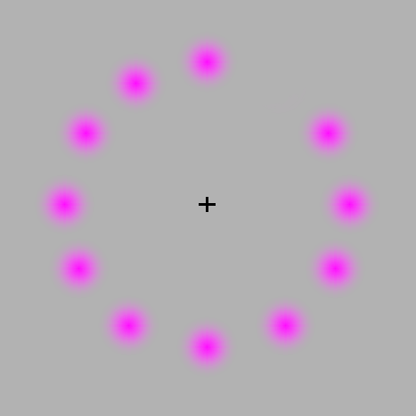
Notes:
In this optical illusion, if you follow the movement of the rotating pink dot with your eyes, the dots will remain only one colour, pink.
However, if you stare at the black + in the center, the moving dot will turn green.
Keep concentrating on the black + in the center of the picture.
After a short period, all the pink dots will slowly disappear and you will only see a single green dot moving in a circle
Ask students:
What did you see?
What was the trick?
Who was tricked?

Slide 4
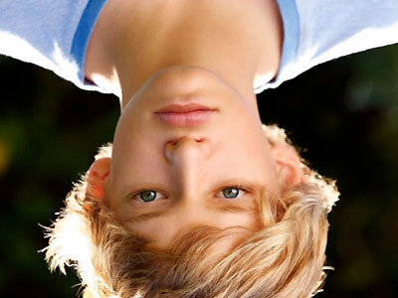
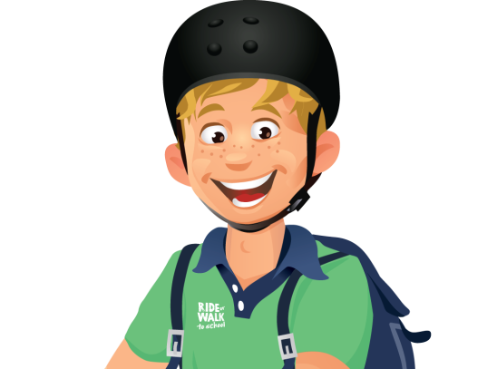
What’s wrong with his face?

Slide 5
Notes:
Ask students:
What did you see?
What was the trick?
Who was tricked?

Slide 6
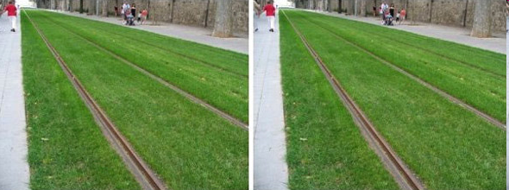
Are these the same photo?
Notes:
Ask students:
What did you see?
What was the trick?
Who was tricked?

Slide 7

Click on the box to start video
Do this video test
Notes:
If you cannot get the video to work copy this link into your internet browser
http://www.youtube.com/watch?v=Ahg6qcgoay4

